Slide 1
Criminal records with hearing schedules, status and judges allotted with judgement
By:
Adepu Nithinvas (20BCS017)
Vadhyavath Naveen(20BEC117)
Rayapur Pradham(20bcs181)

Slide 2
Introduction
This document lays out a project plan for the development of the “CRIMINAL RECORDS”. The intended readers of this document are respectable professor and teaching assistants. This document focuses on explaining the aspects and functionality of the project.

Slide 3
Purpose
In today’s world, owning to the heavy workload on the police officers and court judges , they are having a huge amount of stress in their lives. With the presence of so much of paperwork in and around them, they are not able to decrease their workload. we aim to develop an application that would enable them to reduce paperwork and increase the efficiency in managing the data.
The scope is to enable a user-friendly platform to store and retrieve the criminal records with least efforts.

Slide 4
OVERALL DESCRIPTION
A web based front end for Judge registration by entering Judge details including the id, name, password, case number, hearing status, email and hearing date.
A web based front end for searching, adding, deleting the criminal and traffic records by admin and police with criminal id
A web based front end for logging in and seeing his allotted case, status and hearing date.
A web based front end for police registration by entering police details including the id, name, password, address, phone number, email.
A relational database schema to store, retrieve and update the data in an efficient way.

Slide 5
Modules used
There are three modules namely Admin, Police, Judge
Admin can add police and judge.
Admin can insert, delete criminal records and judges hearing schedule and status.
Police can login using credentials provided by Admin.
Police can search, add and insert criminal and traffic records.
Judge can login using credentials provided by Admin.
Judge can see the case allotted , status and hearing time of the allotted case

Slide 6
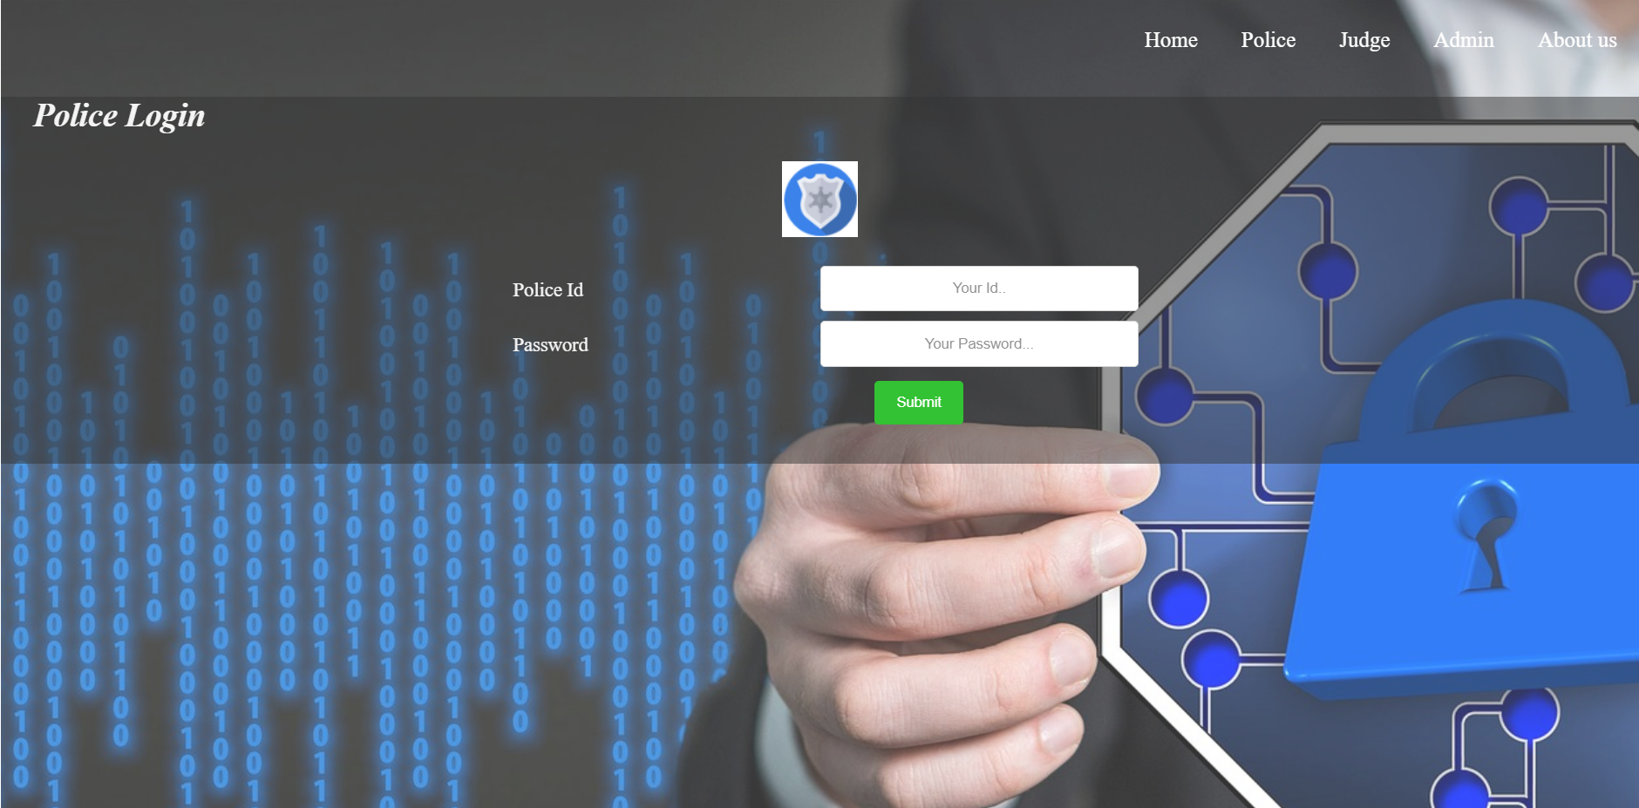

Slide 7
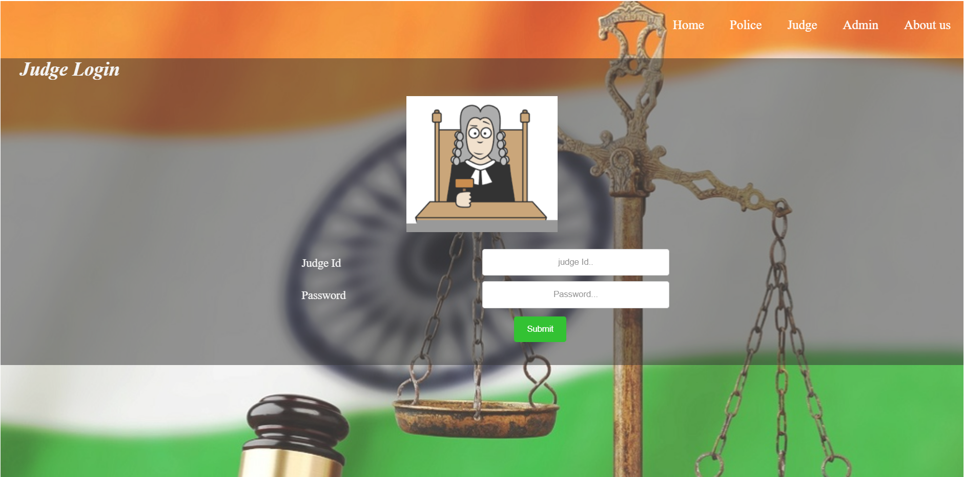

Slide 8


Slide 9
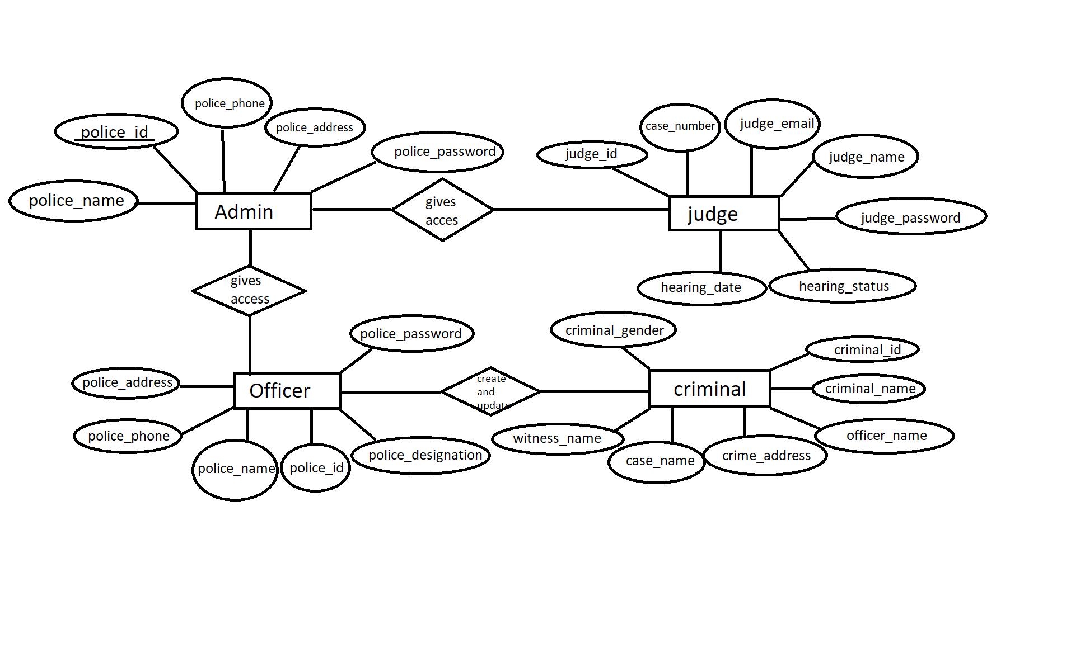
ER diagram

Slide 10
Thank you

